Slide 1


Lawal Rasheed
5th October 2022

Slide 2

Outline
Executive Summary
Introduction
Methodology
Results
Conclusion
Appendix

Slide 3
Executive Summary
Summary of methodologies:
Data Collection through API.
Data Collection with Web Scraping.
Data Wrangling.
Exploratory Data Analysis with Data Visualization.
Interactive Visual Analytics with Folium.
Machine Learning Prediction.
Summary of all results:
Exploratory Data Analysis result.
Interactive analytics in screenshots.
Predictive Analytics result.

Slide 4
Introduction
Project background and context
Space X advertises Falcon 9 rocket launches on its website with a cost of 62 million dollars; other providers cost upward of 165 million dollars each, much of the savings is because Space X can reuse the first stage. Therefore, if we can determine if the first stage will land, we can determine the cost of a launch. This information can be used if an alternate company wants to bid against space X for a rocket launch. This goal of the project is to create a machine learning pipeline to predict if the first stage will land successfully.
Problems you want to find answers to includes:
What factors determine if the rocket will land successfully?
The interaction amongst various features that determine the success rate of a successful landing.
What operating conditions needs to be in place to ensure a successful landing program?

Slide 5


Slide 6
Methodology
Executive Summary
Data collection methodology:
Data was collected using SpaceX API and web scraping from Wikipedia.
Perform data wrangling:
One-hot encoding was applied to categorical features.
Perform interactive visual analytics using Folium and Plotly Dash.
Perform predictive analysis using classification models:
How to build, tune, evaluate classification models.

Slide 7
Data Collection
The data was collected using various methods
Data collection was done using get request to the SpaceX API.
Next, we decoded the response content as a Json using .json() function call and turn it into a pandas data frame using .json_normalize().
We then cleaned the data, checked for missing values and fill in missing values where necessary.
In addition, we performed web scraping from Wikipedia for Falcon 9 launch records with BeautifulSoup.
The objective was to extract the launch records as HTML table, parse the table and convert it to a pandas data frame for future analysis.

Slide 8
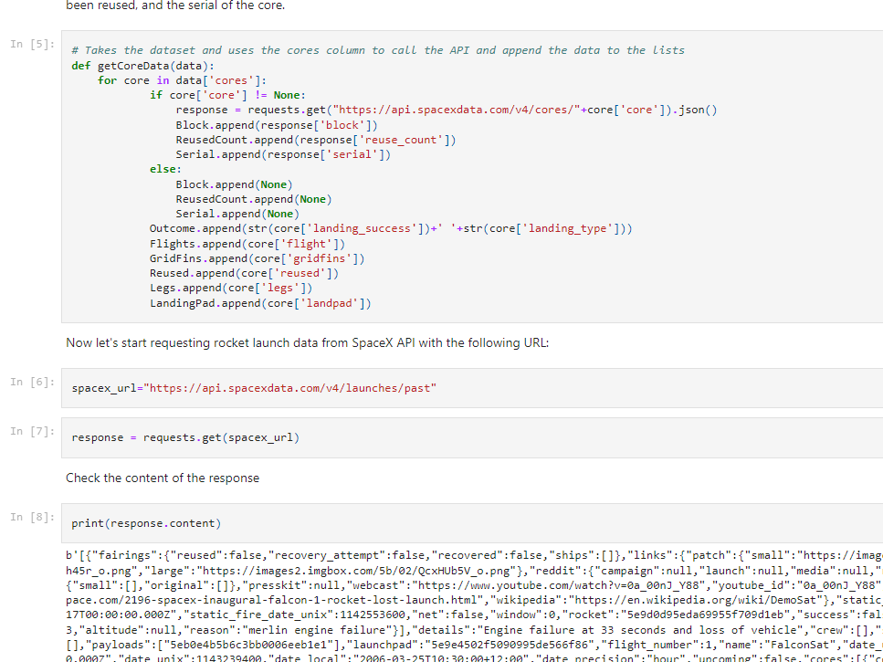
Data Collection – SpaceX API
We used the get request to the SpaceX API to collect data, clean the requested data and did some basic data wrangling and formatting.
The link to the notebook is: https://github.com/rashyd027/Applied-Data-Science-Capstone/blob/main/jupyter-labs-spacex-data-collection.ipynb

Slide 9
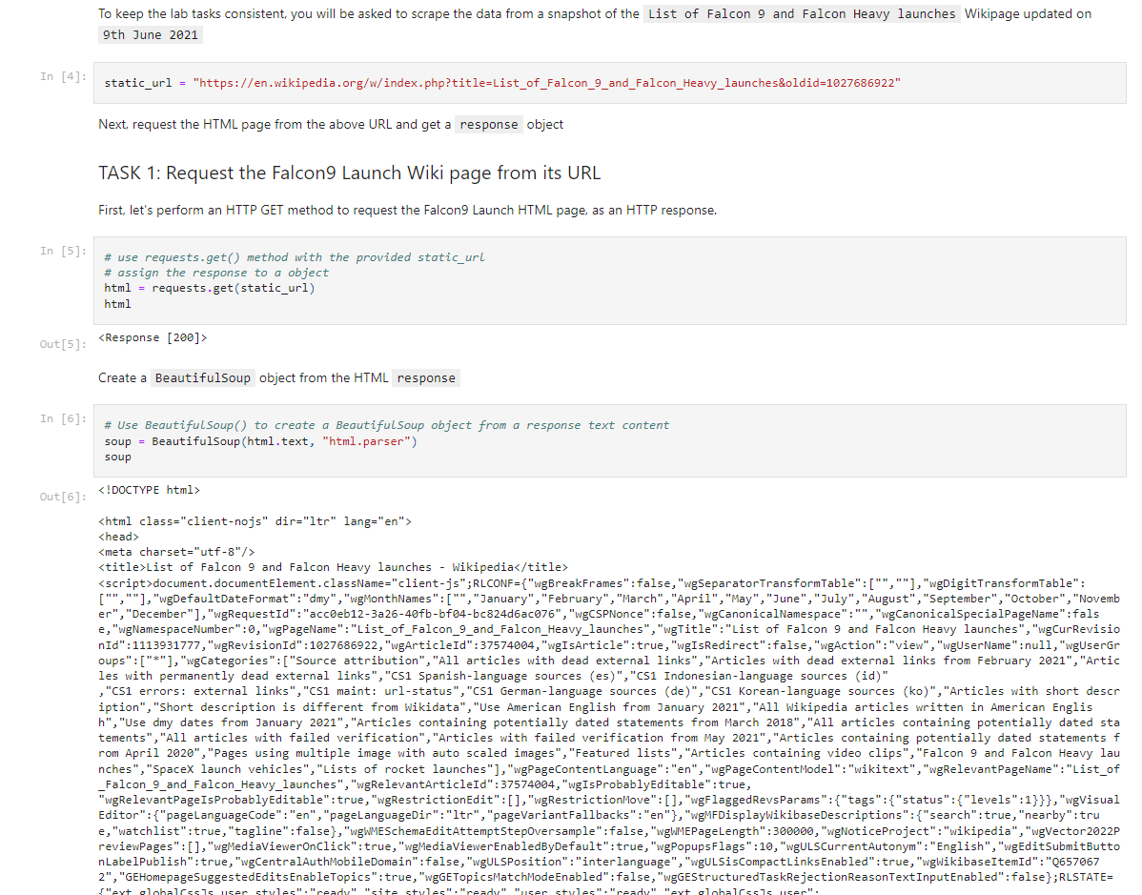
Data Collection – Web-Scraping
We applied web scrapping to webscrap Falcon 9 launch records with BeautifulSoup
We parsed the table and converted it into a pandas dataframe.
The link to the notebook is: https://github.com/rashyd027/Applied-Data-Science-Capstone/blob/main/Data%20Collection%20with%20Webscraping.ipynb

Slide 10

Data Wrangling
We performed exploratory data analysis and determined the training labels.
We calculated the number of launches at each site, and the number and occurrence of each orbits
We created landing outcome label from outcome column and exported the results to csv.
The link to the notebook is: https://github.com/rashyd027/Applied-Data-Science-Capstone/blob/main/Spacex-Data%20wrangling.ipynb

Slide 11
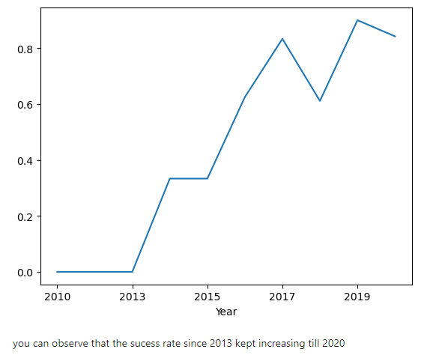
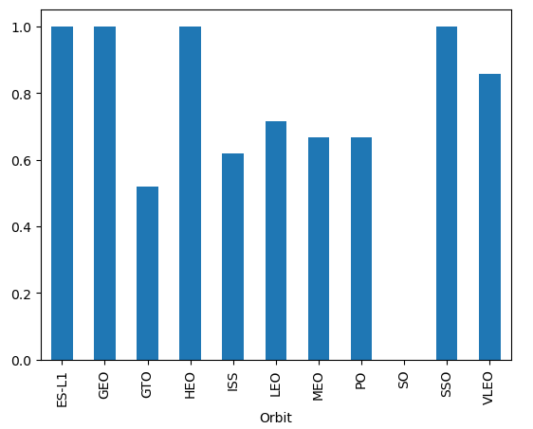
EDA with Data Visualization
We explored the data by visualizing the relationship between flight number and launch Site, payload and launch site, success rate of each orbit type, flight number and orbit type, the launch success yearly trend.
The link to the notebook is: https://github.com/rashyd027/Applied-Data-Science-Capstone/blob/main/EDA%20with%20Visualization%20Lab.ipynb

Slide 12
Build an Interactive Map with Folium
We marked all launch sites, and added map objects such as markers, circles, lines to mark the success or failure of launches for each site on the folium map.
We assigned the feature launch outcomes (failure or success) to class 0 and 1.i.e., 0 for failure, and 1 for success.
Using the color-labeled marker clusters, we identified which launch sites have relatively high success rate.
We calculated the distances between a launch site to its proximities. We answered some question for instance:
Are launch sites near railways, highways and coastlines.
Do launch sites keep certain distance away from cities.

Slide 13
Build a Dashboard with Plotly Dash
We built an interactive dashboard with Plotly dash.
We plotted pie charts showing the total launches by a certain sites.
We plotted scatter graph showing the relationship with Outcome and Payload Mass (Kg) for the different booster version.
The link to the notebook is: https://github.com/rashyd027/Applied-Data-Science-Capstone/blob/main/Spacex_plotly_dash.ipynb

Slide 14
Predictive Analysis (Classification)
We loaded the data using numpy and pandas, transformed the data, split our data into training and testing.
We built different machine learning models and tune different hyperparameters using GridSearchCV.
We used accuracy as the metric for our model, improved the model using feature engineering and algorithm tuning.
We found the best performing classification model.
The link to the notebook is https://github.com/rashyd027/Applied-Data-Science-Capstone/blob/main/Machine%20Learning%20Prediction%20Lab.ipynb

Slide 15
Results
Exploratory data analysis results
Interactive analytics demo in screenshots
Predictive analysis results

Slide 16


Slide 17

Flight Number vs. Launch Site
From the plot, we found that the larger the flight amount at a launch site, the greater the success rate at a launch site.

Slide 18


Payload vs. Launch Site

Slide 19

Flight Number vs. Orbit Type
The plot below shows the Flight Number vs. Orbit type. We observe that in the LEO orbit, success is related to the number of flights whereas in the GTO orbit, there is no relationship between flight number and the orbit.

Slide 20

Payload vs. Orbit Type
We can observe that with heavy payloads, the successful landing are more for PO, LEO and ISS orbits.

Slide 21


Slide 22

All launch sites global map markers

Slide 23

Markers showing launch sites with color labels

Slide 24

Launch Site distance to landmarks

Slide 25


Slide 26

Pie chart showing the success percentage achieved by each launch site

Slide 27

Pie chart showing the Launch site with the highest launch success ratio

Slide 28

Scatter plot of Payload vs Launch Outcome for all sites, with different payload selected in the range slider

Slide 29


Slide 30

Classification Accuracy
The decision tree classifier is the model with the highest classification accuracy

Slide 31

Confusion Matrix
The confusion matrix for the decision tree classifier shows that the classifier can distinguish between the different classes. The major problem is the false positives .i.e., unsuccessful landing marked as successful landing by the classifier.

Slide 32
Conclusions
We can conclude that:
The larger the flight amount at a launch site, the greater the success rate at a launch site.
Launch success rate started to increase in 2013 till 2020.
Orbits ES-L1, GEO, HEO, SSO, VLEO had the most success rate.
KSC LC-39A had the most successful launches of any sites.
The Decision tree classifier is the best machine learning algorithm for this task.

Slide 33


